Slide 1

Artificial Intelligence
for developers
8 weekend per diventare Machine Learning Specialist

Slide 2


Natural Language Processing
Maurizio Atzori
Università degli Studi di Cagliari
atzori@unica.it
February 9-10 , 2024

Slide 3
Outline of the course
Intro on AI, ML and NLP
Text Processing
Words and Corpora
Lexical similarity
Language Modeling
Text Classification
Semantic similarity
Knowledge Graphs
Intro to Large Language Models

Slide 4
The task
Text Classification

Slide 5
Is this spam?

Slide 6
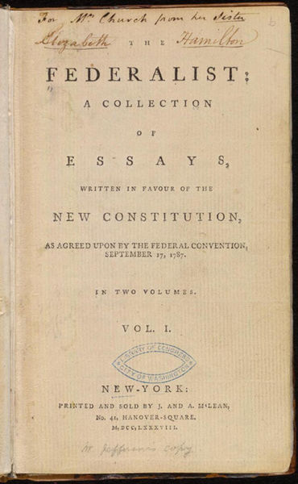
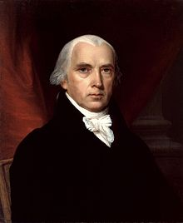
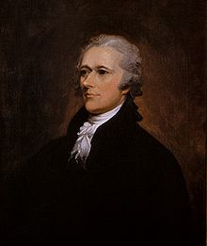
Who wrote which Federalist papers?
1787-8: anonymous essays try to convince New York to ratify U.S Constitution: Jay, Madison, Hamilton.
Authorship of 12 of the letters in dispute
1963: solved by Mosteller and Wallace using Bayesian methods
James Madison
Alexander Hamilton

Slide 7
What is the subject of this medical article?
MEDLINE Article
MeSH Subject Category Hierarchy
Antogonists and Inhibitors
Blood Supply
Chemistry
Drug Therapy
Embryology
Epidemiology
…
?

Slide 8
Positive or negative movie review?
+
...zany characters and richly applied satire, and some great plot twists
It was pathetic. The worst part about it was the boxing scenes...
...awesome caramel sauce and sweet toasty almonds. I love this place!
...awful pizza and ridiculously overpriced...
−
+
−

Slide 9
Positive or negative movie review?
+
...zany characters and richly applied satire, and some great plot twists
It was pathetic. The worst part about it was the boxing scenes...
...awesome caramel sauce and sweet toasty almonds. I love this place!
...awful pizza and ridiculously overpriced...
−
+
−

Slide 10
Why sentiment analysis?
Movie: is this review positive or negative?
Products: what do people think about the new iPhone?
Public sentiment: how is consumer confidence?
Politics: what do people think about this candidate or issue?
Prediction: predict election outcomes or market trends from sentiment

Slide 11
Scherer Typology of Affective States
Emotion: brief organically synchronized … evaluation of a major event
angry, sad, joyful, fearful, ashamed, proud, elated
Mood: diffuse non-caused low-intensity long-duration change in subjective feeling
cheerful, gloomy, irritable, listless, depressed, buoyant
Interpersonal stances: affective stance toward another person in a specific interaction
friendly, flirtatious, distant, cold, warm, supportive, contemptuous
Attitudes: enduring, affectively colored beliefs, dispositions towards objects or persons
liking, loving, hating, valuing, desiring
Personality traits: stable personality dispositions and typical behavior tendencies
nervous, anxious, reckless, morose, hostile, jealous

Slide 12
Scherer Typology of Affective States
Emotion: brief organically synchronized … evaluation of a major event
angry, sad, joyful, fearful, ashamed, proud, elated
Mood: diffuse non-caused low-intensity long-duration change in subjective feeling
cheerful, gloomy, irritable, listless, depressed, buoyant
Interpersonal stances: affective stance toward another person in a specific interaction
friendly, flirtatious, distant, cold, warm, supportive, contemptuous
Attitudes: enduring, affectively colored beliefs, dispositions towards objects or persons
liking, loving, hating, valuing, desiring
Personality traits: stable personality dispositions and typical behavior tendencies
nervous, anxious, reckless, morose, hostile, jealous

Slide 13
Basic Sentiment Classification
Sentiment analysis is the detection of attitudes
Simple task we focus on in this chapter
Is the attitude of this text positive or negative?
We return to affect classification in later chapters

Slide 14
Summary: Text Classification
Sentiment analysis
Spam detection
Authorship identification
Language Identification
Assigning subject categories, topics, or genres
…

Slide 15
Text Classification: definition
Input:
a document d
a fixed set of classes C = {c₁, c₂,…, c_{J}}
Output: a predicted class c ∈ C

Slide 16
Classaification Methods: Hand-coded rules
Rules based on combinations of words or other features
spam: black-list-address OR (“dollars” AND “you have been selected”)
Accuracy can be high
If rules carefully refined by expert
But building and maintaining these rules is expensive

Slide 17
Classification Methods: Supervised Machine Learning
Input:
a document d
a fixed set of classes C = {c₁, c₂,…, c_{J}}
A training set of m hand-labeled documents (d₁,c₁),....,(d_{m},c_{m})
Output:
a learned classifier γ:d → c

Slide 18
Classification Methods: Supervised Machine Learning
Any kind of classifier
Naïve Bayes
Logistic regression
Neural networks
k-Nearest Neighbors
…

Slide 19
The task
Text Classification

Slide 20
The Naive Bayes Classifier
Text Classification

Slide 21
Naive Bayes Intuition
Simple ("naive") classification method based on Bayes rule
Relies on very simple representation of document
Bag of words

Slide 22
The Bag of Words Representation

Slide 23


The bag of words representation
seen | 2
sweet | 1
whimsical | 1
recommend | 1
happy | 1
... | ...
γ(
)=c

Slide 24
Bayes’ Rule Applied to Documents and Classes
For a document d and a class c

Slide 25
Naive Bayes Classifier (I)
MAP is “maximum a posteriori” = most likely class
Bayes Rule
Dropping the denominator

Slide 26
Naive Bayes Classifier (II)
"Likelihood"
"Prior"
Document d represented as features x1..xn

Slide 27
Naïve Bayes Classifier (IV)
O(|X|^{n}•|C|) parameters
How often does this class occur?
Could only be estimated if a very, very large number of training examples was available.
We can just count the relative frequencies in a corpus

Slide 28
Multinomial Naive Bayes Independence Assumptions
Bag of Words assumption: Assume position doesn’t matter
Conditional Independence: Assume the feature probabilities P(x_{i}|c_{j}) are independent given the class c.

Slide 29
Multinomial Naive Bayes Classifier

Slide 30
Applying Multinomial Naive Bayes Classifiers to Text Classification
positions ← all word positions in test document

Slide 31
Problems with multiplying lots of probs
There's a problem with this:
Multiplying lots of probabilities can result in floating-point underflow!
.0006 * .0007 * .0009 * .01 * .5 * .000008….
Idea: Use logs, because log(ab) = log(a) + log(b)
We'll sum logs of probabilities instead of multiplying probabilities!

Slide 32
We actually do everything in log space
Instead of this:
This:
Notes:
1) Taking log doesn't change the ranking of classes!
The class with highest probability also has highest log probability!
2) It's a linear model:
Just a max of a sum of weights: a linear function of the inputs
So naive bayes is a linear classifier

Slide 33
The Naive Bayes Classifier
Text Classification

Slide 34
Naive Bayes: Learning
Text Classification

Slide 35
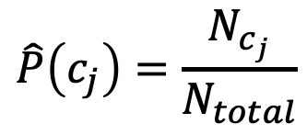
Learning the Multinomial Naive Bayes Model
Sec.13.3
First attempt: maximum likelihood estimates
simply use the frequencies in the data
$$\hat{P}\left(c_{j}\right)=\frac{N_{c_{j}}}{N_{total}}$$

Slide 36
Parameter estimation
fraction of times word w_{i} appears
among all words in documents of topic c_{j}
Create mega-document for topic j by concatenating all docs in this topic
Use frequency of w in mega-document

Slide 37
Problem with Maximum Likelihood
Sec.13.3
What if we have seen no training documents with the word fantastic and classified in the topic positive (thumbs-up)?
Zero probabilities cannot be conditioned away, no matter the other evidence!

Slide 38
Laplace (add-1) smoothing for Naïve Bayes

Slide 39
Multinomial Naïve Bayes: Learning
From training corpus, extract Vocabulary
Calculate P(c_{j}) terms
For each c_{j} in C do
docs_{j} ← all docs with class =c_{j}
Calculate P(w_{k} | c_{j}) terms
Text_{j} ← single doc containing all docs_{j}
For each word w_{k} in Vocabulary
n_{k} ← # of occurrences of w_{k} in Text_{j}

Slide 40
Unknown words
What about unknown words
that appear in our test data
but not in our training data or vocabulary?
We ignore them
Remove them from the test document!
Pretend they weren't there!
Don't include any probability for them at all!
Why don't we build an unknown word model?
It doesn't help: knowing which class has more unknown words is not generally helpful!

Slide 41
Stop words
Some systems ignore stop words
Stop words: very frequent words like the and a.
Sort the vocabulary by word frequency in training set
Call the top 10 or 50 words the stopword list.
Remove all stop words from both training and test sets
As if they were never there!
But removing stop words doesn't usually help
So in practice most NB algorithms use all words and don't use stopword lists

Slide 42
Naive Bayes: Learning
Text Classification

Slide 43
Naive Bayes: Sentiment and Binary NB
Text Classification

Slide 44
Let's do a worked sentiment example!

Slide 45
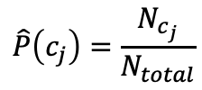
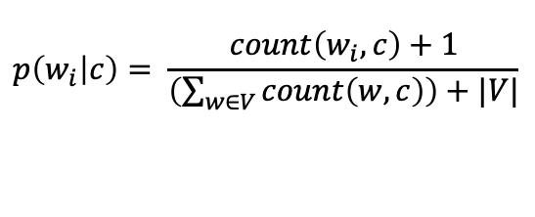
A worked sentiment example with add-1 smoothing
1. Prior from training:
$$\hat{P}\left(c_{j}\right)=\frac{N_{c_{j}}}{N_{total}}$$
P(-) = 3/5
P(+) = 2/5
2. Drop "with"
3. Likelihoods from training:
$$p\left(w_{i} | c\right)= \frac{count\left(w_{i},c\right)+1}{\left(\sum_{w∈V}{count\left(w,c\right)}\right)+|V|}$$
4. Scoring the test set:

Slide 46
Optimizing for sentiment analysis
For tasks like sentiment, word occurrence seems to be more important than word frequency.
The occurrence of the word fantastic tells us a lot
The fact that it occurs 5 times may not tell us much more.
Binary multinominal naive bayes, or binary NB
Clip our word counts at 1
Note: this is different than Bernoulli naive bayes; see the textbook at the end of the chapter.

Slide 47
Binary Multinomial Naïve Bayes: Learning
From training corpus, extract Vocabulary
Calculate P(c_{j}) terms
For each c_{j} in C do
docs_{j} ← all docs with class =c_{j}
Calculate P(w_{k} | c_{j}) terms
Text_{j} ← single doc containing all docs_{j}
For each word w_{k} in Vocabulary
n_{k} ← # of occurrences of w_{k} in Text_{j}
Remove duplicates in each doc:
For each word type w in doc_{j}
Retain only a single instance of w

Slide 48
Binary Maultinomial Naive Bayes on a test document d
First remove all duplicate words from d
Then compute NB using the same equation:

Slide 49
Binary multinominal naive Bayes

Slide 50
Binary multinominal naive Bayes

Slide 51
Binary multinominal naive Bayes

Slide 52
Binary multinominal naive Bayes
Counts can still be 2! Binarization is within-doc!

Slide 53
Naive Bayes: Sentiment and Binary NB
Text Classification

Slide 54
More on Sentiment Classification
Text Classification

Slide 55
Sentiment Classification: Dealing with Negation
I really like this movie
I really don't like this movie
Negation changes the meaning of "like" to negative.
Negation can also change negative to positive-ish
Don't dismiss this film
Doesn't let us get bored

Slide 56
Sentiment Classification: Dealing with Negation
Das, Sanjiv and Mike Chen. 2001. Yahoo! for Amazon: Extracting market sentiment from stock message boards. In Proceedings of the Asia Pacific Finance Association Annual Conference (APFA).
Bo Pang, Lillian Lee, and Shivakumar Vaithyanathan. 2002. Thumbs up? Sentiment Classification using Machine Learning Techniques. EMNLP-2002, 79—86.
Simple baseline method:
Add NOT_ to every word between negation and following punctuation:
didn’t like this movie , but I
didn’t NOT_like NOT_this NOT_movie but I

Slide 57
Sentiment Classification: Lexicons
Sometimes we don't have enough labeled training data
In that case, we can make use of pre-built word lists
Called lexicons
There are various publically available lexicons

Slide 58
MPQA Subjectivity Cues Lexicon
Theresa Wilson, Janyce Wiebe, and Paul Hoffmann (2005). Recognizing Contextual Polarity in
Phrase-Level Sentiment Analysis. Proc. of HLT-EMNLP-2005.
Riloff and Wiebe (2003). Learning extraction patterns for subjective expressions. EMNLP-2003.
Home page: https://mpqa.cs.pitt.edu/lexicons/subj_lexicon/
6885 words from 8221 lemmas, annotated for intensity (strong/weak)
2718 positive
4912 negative
+ : admirable, beautiful, confident, dazzling, ecstatic, favor, glee, great
− : awful, bad, bias, catastrophe, cheat, deny, envious, foul, harsh, hate

Slide 59
The General Inquirer
Philip J. Stone, Dexter C Dunphy, Marshall S. Smith, Daniel M. Ogilvie. 1966. The General Inquirer: A Computer Approach to Content Analysis. MIT Press
Home page: http://www.wjh.harvard.edu/~inquirer
List of Categories: http://www.wjh.harvard.edu/~inquirer/homecat.htm
Spreadsheet: http://www.wjh.harvard.edu/~inquirer/inquirerbasic.xls
Categories:
Positiv (1915 words) and Negativ (2291 words)
Strong vs Weak, Active vs Passive, Overstated versus Understated
Pleasure, Pain, Virtue, Vice, Motivation, Cognitive Orientation, etc
Free for Research Use

Slide 60
Using Lexicons in Sentiment Classification
Add a feature that gets a count whenever a word from the lexicon occurs
E.g., a feature called "this word occurs in the positive lexicon" or "this word occurs in the negative lexicon"
Now all positive words (good, great, beautiful, wonderful) or negative words count for that feature.
Using 1-2 features isn't as good as using all the words.
But when training data is sparse or not representative of the test set, dense lexicon features can help

Slide 61
Naive Bayes in Other tasks: Spam Filtering
SpamAssassin Features:
Mentions millions of (dollar) ((dollar) NN,NNN,NNN.NN)
From: starts with many numbers
Subject is all capitals
HTML has a low ratio of text to image area
"One hundred percent guaranteed"
Claims you can be removed from the list

Slide 62
Naive Bayes in Language ID
Determining what language a piece of text is written in.
Features based on character n-grams do very well
Important to train on lots of varieties of each language
(e.g., American English varieties like African-American English, or English varieties around the world like Indian English)

Slide 63
Summary: Naive Bayes is Not So Naive
Very Fast, low storage requirements
Work well with very small amounts of training data
Robust to Irrelevant Features
Irrelevant Features cancel each other without affecting results
Very good in domains with many equally important features
Decision Trees suffer from fragmentation in such cases – especially if little data
Optimal if the independence assumptions hold: If assumed independence is correct, then it is the Bayes Optimal Classifier for problem
A good dependable baseline for text classification
Slide from Chris Manning

Slide 64
More on Sentiment Classification
Text Classification

Slide 65
Multiclass (skip)
Text Classification

Slide 66
Confusion Matrix for 3-class classification

Slide 67
How to combine P/R from 3 classes to get one metric
Macroaveraging:
compute the performance for each class, and then average over classes
Microaveraging:
collect decisions for all classes into one confusion matrix
compute precision and recall from that table.

Slide 68
Macroaveraging and Microaveraging

Slide 69
Multiclass (skip)
Text Classification

Slide 70
Avoiding Harms in Classification
Text Classification

Slide 71
Harms in sentiment classifiers
Kiritchenko and Mohammad (2018) found that most sentiment classifiers assign lower sentiment and more negative emotion to sentences with African American names in them.
This perpetuates negative stereotypes that associate African Americans with negative emotions

Slide 72
Harms in toxicity classification
Toxicity detection is the task of detecting hate speech, abuse, harassment, or other kinds of toxic language
But some toxicity classifiers incorrectly flag as being toxic sentences that are non-toxic but simply mention identities like blind people, women, or gay people.
This could lead to censorship of discussion about these groups.

Slide 73
What causes these harms?
Can be caused by:
Problems in the training data; machine learning systems are known to amplify the biases in their training data.
Problems in the human labels
Problems in the resources used (like lexicons)
Problems in model architecture (like what the model is trained to optimized)
Mitigation of these harms is an open research area
Meanwhile: model cards

Slide 74
Model Cards
(Mitchell et al., 2019)
For each algorithm you release, document:
training algorithms and parameters
training data sources, motivation, and preprocessing
evaluation data sources, motivation, and preprocessing
intended use and users
model performance across different demographic or other groups and environmental situations

Slide 75
Avoiding Harms in Classification
Text Classification

